Slide 1
Multiple Sequence Alignments (MSA)
Goal:
Detection of conserved regions for
Evolutionary clues
Features important for structure and function
Applications:
PSSMs/Profile HMMs
Phylogenetic tree construction
Protein secondary and tertiary structure prediction
Methods:
MSA methods employing dynamic programming are impractical for more than a few sequences (how can DP be extended for multiple sequences?)
Heuristic approaches not guaranteed to identify ‘the’ optimal alignment but something close to it and are fast (and therefore, practical)
Notes:
MSAs provide insights into how the sequences in a protein family evolved and what features are important for structure and function
MSAs are important for variety of applications including PSSMs and its relative profile HMMs, for phylogenetic tree construction, and for protein secondary and tertiary structure prediction
Although DP methods can be used just like in the case of pairwise alignments, they are too computationally extremely intensive for anything more than maybe 10 sequences. For MSAs, it's not uncommon to have hundreds and even thousands of sequences, so we need approaches that are computationally more tractable.
Once again, heuristic approaches have been developed that are not guaranteed to identify optimal alignments but something close to it but are extremely fast and hence are practical.

Slide 2
Progressive Multiple Sequence Alignment (PMSA)
Problem:
Given a set of related sequences, generate a global MSA
Progressive Alignment – A Typical Heuristic for MSAs
Construct all possible pairwise alignments
Choose the most similar pair of sequences; align; fix alignment
Align the next closely related sequence to the first alignment; iterate
Features:
Fast and efficient; results are generally reasonable
Does not directly optimize any global scoring function of alignment correctness; it does optimize the score for aligning a new sequence(s) with the emerging alignment
Notes:
Obviously, the sequences need to be related in order to generate a MSA. Unlike a pairwise alignment for which you might generate a local or a global alignment, MSAs are by construction global.
The most commonly used heuristic is something known as progressive alignment. The general approach here is to construct a series of pairwise alignments to find the most similar pair. Align these sequences and freeze the alignment. Add a third sequence to the first alignment and iterate.

Slide 3
CLUSTAL W* - Profile based PMSA
Algorithm:
Calculate pairwise alignments of all N(N - 1)/2 pairs through a dynamic programming approach
Convert similarity scores from pairwise alignments to evolutionary distances and construct distance matrix
Use distance matrix to construct a guide tree via neighbor-joining algorithm
Progressively align sequences following guide tree (i.e., start with most closely related sequence pairs, realign with the addition of the next sequence and iterate)
See CLUSTAL W paper by Thompson et al., (1994) on Canvas
Notes:
We are going to discuss the approach pioneered by Thompson and coworkers. They developed this program called CLUSTAL W which turned out to be extremely successful. Other approaches have been developed since, but since you'll be using a newer version of this program called CLUSTAL Omega for generating MSAs, it makes sense to understand the nuts and bolts of this approach because other approaches emulate this approach.
Step 1 is probably familiar and that is used as the basis for steps 2 and 3. Steps 2 and 3 are critical because they are used to generate a schedule for adding sequences or sub-alignments one at a time.

Slide 4
 |  | 1 | 2 | 3 | 4 | 5 | 6
Hbb_Human | 1 | -
Hbb_Horse | 2 | .17 | -
Hba_Human | 3 | .59 | .60 | -
Hba_Horse | 4 | .59 | .59 | .13 | -
Myg_Phyca | 5 | .77 | .77 | .75 | .75 | -
Glb5_Petma | 6 | .81 | .82 | .73 | .74 | .80 | -
Lgb2_Luplu | 7 | .87 | .86 | .86 | .88 | .93 | .90
pairwise alignments
distance matrix
weights
.226
.081
Hbb_Human
0.221
.061
.084
Hbb_Horse
0.225
construct rooted guide tree
.219
.055
Hba_Human
0.194
.015
.065
Hba_Horse
0.203
.062
.398
Myg_Phyca
0.411
.389
Glb5_Petma
0.398
.442
Lgb2_Luplu
0.442
calculate sequence weights
HBB_HUMAN --------VHLTPEEKSAVTALWGKVNV--DEVGGEALGRLLVVYPWTQRFFESFGDLST
HBB_HORSE --------VQLSGEEKAAVLALWDKVNE--EEVGGEALGRLLVVYPWTQRFFDSFGDLSN
HBA_HUMAN ---------VLSPADKTNVKAAWGKVGAHAGEYGAEALERMFLSFPTTKTYFPHFDL---
HBA_HORSE ---------VLSAADKTNVKAAWSKVGGHAGEYGAEALERMFLGFPTTKTYFPHFDL---
MYG_PHYCA ---------VLSEGEWQLVLHVWAKVEADVAGHGQDILIRLFKSHPETLEKFDRFKHLKT
GLB5_PETMA PIVDTGSVAPLSAAEKTKIRSAWAPVYSTYETSGVDILVKFFTSTPAAQEFFPKFKGLTT
LGB2_LUPLU --------GALTESQAALVKSSWEEFNANIPKHTHRFFILVLEIAPAAKDLFSFLKGTSE
*: : : * . : .: * : * :
HBB_HUMAN PDAVMGNPKVKAHGKKVLGAFSDGLAHLDNLKG-----TFATLSELHCDKLHVDPENFRL
HBB_HORSE PGAVMGNPKVKAHGKKVLHSFGEGVHHLDNLKG-----TFAALSELHCDKLHVDPENFRL
HBA_HUMAN ---SHGSAQVKGHGKKVADALTNAVAHVDDMPN-----ALSALSDLHAHKLRVDPVNFKL
HBA_HORSE ---SHGSAQVKAHGKKVGDALTLAVGHLDDLPG-----ALSNLSDLHAHKLRVDPVNFKL
MYG_PHYCA EAEMKASEDLKKHGVTVLTALGAILKKKGHHEA-----ELKPLAQSHATKHKIPIKYLEF
GLB5_PETMA ADQLKKSADVRWHAERIINAVNDAVASMDDTEK--MSMKLRDLSGKHAKSFQVDPQYFKV
LGB2_LUPLU --VPQNNPELQAHAGKVFKLVYEAAIQLEVTGVVVTDATLKNLGSVHVSKG-VADAHFPV
. .:: *. : . : *. * . : : .
HBB_HUMAN LGNVLVCVLAHHFGKEFTPPVQAAYQKVVAGVANALAHKYH------
HBB_HORSE LGNVLVVVLARHFGKDFTPELQASYQKVVAGVANALAHKYH------
HBA_HUMAN LSHCLLVTLAAHLPAEFTPAVHASLDKFLASVSTVLTSKYR------
HBA_HORSE LSHCLLSTLAVHLPNDFTPAVHASLDKFLSSVSTVLTSKYR------
MYG_PHYCA ISEAIIHVLHSRHPGDFGADAQGAMNKALELFRKDIAAKYKELGYQG
GLB5_PETMA LAAVIADTVAA---------GDAGFEKLMSMICILLRSAY-------
LGB2_LUPLU VKEAILKTIKEVVGAKWSEELNSAWTIAYDELAIVIKKEMNDAA---
: : .: ... . :
progressive alignment following guide tree
Notes:
Here's a more detailed flowchart along with the results on the right.
All sequences are aligned in pairs and an evolutionary distance (based on sequence similarity) between them is calculated to produce a distance matrix.
The matrix is then used to produce a guide tree that establishes how the sequences evolved from a common ancestor. The most recent common ancestor in the tree diagram is to the left and is called the root whereas the sequences at the tips of each branch are called leaves.
Note that the sequence weights are used to calculate the alignment score; contributions to the score from closely-related sequences are downweighted whereas those from more diverse sequences are upweighted to correct for the uneven sampling of sequences at different evolutionary distances.

Slide 5
Progressive Alignment Schedule:
.226
.081
Hbb_Human
Iteration 1:
Align Hba_Human and Hba_Horse
.084
Hbb_Horse
.061
.055
Hba_Human
Iteration 2:
Align Hbb_Human and Hbb_Horse
.015
.219
.065
Hba_Horse
.062
.398
Myg_Phyca
Iteration 3:
Align Hba and Hbb alignments
.389
Glb5_Petma
.442
Lgb2_Luplu
HBA_HUMAN VLSPADKTNVKAAWGKVGAHAGEYGAEALERMFLSFPTTKTYFPHFDLSHGSAQVKGHGK
HBA_HORSE VLSAADKTNVKAAWSKVGGHAGEYGAEALERMFLGFPTTKTYFPHFDLSHGSAQVKAHGK
*** **********.***.***************.*********************.***
HBA_HUMAN KVADALTNAVAHVDDMPNALSALSDLHAHKLRVDPVNFKLLSHCLLVTLAAHLPAEFTPA
HBA_HORSE KVGDALTLAVGHLDDLPGALSNLSDLHAHKLRVDPVNFKLLSHCLLSTLAVHLPNDFTPA
**.**** **.*:**:*.*** ************************ ***.*** :****
HBA_HUMAN VHASLDKFLASVSTVLTSKYR
HBA_HORSE VHASLDKFLSSVSTVLTSKYR
*********:***********
HBB_HUMAN VHLTPEEKSAVTALWGKVNVDEVGGEALGRLLVVYPWTQRFFESFGDLSTPDAVMGNPKV
HBB_HORSE VQLSGEEKAAVLALWDKVNEEEVGGEALGRLLVVYPWTQRFFDSFGDLSNPGAVMGNPKV
*:*: ***:** ***.*** :*********************:******.*.********
HBB_HUMAN KAHGKKVLGAFSDGLAHLDNLKGTFATLSELHCDKLHVDPENFRLLGNVLVCVLAHHFGK
HBB_HORSE KAHGKKVLHSFGEGVHHLDNLKGTFAALSELHCDKLHVDPENFRLLGNVLVVVLARHFGK
******** :*.:*: **********:************************ ***:****
HBB_HUMAN EFTPPVQAAYQKVVAGVANALAHKYH
HBB_HORSE DFTPELQASYQKVVAGVANALAHKYH
:*** :**:*****************

Slide 6
Progressive Alignment Schedule:
.226
.081
Hbb_Human
Iteration 1:
Align Hba_Human and Hba_Horse
.084
Hbb_Horse
.061
.055
Hba_Human
Iteration 2:
Align Hbb_Human and Hbb_Horse
.015
.219
.065
Hba_Horse
.062
.398
Myg_Phyca
Iteration 3:
Align Hba and Hbb alignments
.389
Glb5_Petma
Iteration 4:
Add Myg_Phyca to the alignment
.442
Lgb2_Luplu
Iteration 5:
Add Glb5_Petma to the alignment
Iteration 6:
Add Lgb2_Luplu to the alignment
HBA_HUMAN -VLSPADKTNVKAAWGKVGAHAGEYGAEALERMFLSFPTTKTYFPHFDL------SHGSA
HBA_HORSE -VLSAADKTNVKAAWSKVGGHAGEYGAEALERMFLGFPTTKTYFPHFDL------SHGSA
HBB_HUMAN VHLTPEEKSAVTALWGKVNV--DEVGGEALGRLLVVYPWTQRFFESFGDLSTPDAVMGNP
HBB_HORSE VQLSGEEKAAVLALWDKVNE--EEVGGEALGRLLVVYPWTQRFFDSFGDLSNPGAVMGNP
*: :*: * * *.**. * *.*** *::: :* *: :* *. *.
HBA_HUMAN QVKGHGKKVADALTNAVAHVDDMPNALSALSDLHAHKLRVDPVNFKLLSHCLLVTLAAHL
HBA_HORSE QVKAHGKKVGDALTLAVGHLDDLPGALSNLSDLHAHKLRVDPVNFKLLSHCLLSTLAVHL
HBB_HUMAN KVKAHGKKVLGAFSDGLAHLDNLKGTFATLSELHCDKLHVDPENFRLLGNVLVCVLAHHF
HBB_HORSE KVKAHGKKVLHSFGEGVHHLDNLKGTFAALSELHCDKLHVDPENFRLLGNVLVVVLARHF
:**.***** :: .: *:*:: .::: **:**..**:*** **:**.: *: .** *:
HBA_HUMAN PAEFTPAVHASLDKFLASVSTVLTSKYR
HBA_HORSE PNDFTPAVHASLDKFLSSVSTVLTSKYR
HBB_HUMAN GKEFTPPVQAAYQKVVAGVANALAHKYH
HBB_HORSE GKDFTPELQASYQKVVAGVANALAHKYH
:*** ::*: :*.::.*:..*: **:
HBA_HUMAN -VLSPADKTNVKAAWGKVGAHAGEYGAEALERMFLSFPTTKTYFPHFDL------SHGSA
HBA_HORSE -VLSAADKTNVKAAWSKVGGHAGEYGAEALERMFLGFPTTKTYFPHFDL------SHGSA
HBB_HUMAN VHLTPEEKSAVTALWGKVNV--DEVGGEALGRLLVVYPWTQRFFESFGDLSTPDAVMGNP
HBB_HORSE VQLSGEEKAAVLALWDKVNE--EEVGGEALGRLLVVYPWTQRFFDSFGDLSNPGAVMGNP
MYG_PHYCA -VLSEGEWQLVLHVWAKVEADVAGHGQDILIRLFKSHPETLEKFDRFKHLKTEAEMKASE
*: : * * ** * : * *:: .* * * * ..
HBA_HUMAN QVKGHGKKVADALTNAVAHVDDMPNALSALSDLHAHKLRVDPVNFKLLSHCLLVTLAAHL
HBA_HORSE QVKAHGKKVGDALTLAVGHLDDLPGALSNLSDLHAHKLRVDPVNFKLLSHCLLSTLAVHL
HBB_HUMAN KVKAHGKKVLGAFSDGLAHLDNLKGTFATLSELHCDKLHVDPENFRLLGNVLVCVLAHHF
HBB_HORSE KVKAHGKKVLHSFGEGVHHLDNLKGTFAALSELHCDKLHVDPENFRLLGNVLVVVLARHF
MYG_PHYCA DLKKHGVTVLTALGAILKKKGHHEAELKPLAQSHATKHKIPIKYLEFISEAIIHVLHSRH
.:* ** .* :: : : .. : *:: *. * :: :.::.. :: .* :
HBA_HUMAN PAEFTPAVHASLDKFLASVSTVLTSKYR------
HBA_HORSE PNDFTPAVHASLDKFLSSVSTVLTSKYR------
HBB_HUMAN GKEFTPPVQAAYQKVVAGVANALAHKYH------
HBB_HORSE GKDFTPELQASYQKVVAGVANALAHKYH------
MYG_PHYCA PGDFGADAQGAMNKALELFRKDIAAKYKELGYQG
:* :.: :* : . . :: **:
HBA_HUMAN ---------VLSPADKTNVKAAWGKVGAHAGEYGAEALERMFLSFPTTKTYFPHFDL---
HBA_HORSE ---------VLSAADKTNVKAAWSKVGGHAGEYGAEALERMFLGFPTTKTYFPHFDL---
HBB_HUMAN --------VHLTPEEKSAVTALWGKVNV--DEVGGEALGRLLVVYPWTQRFFESFGDLST
HBB_HORSE --------VQLSGEEKAAVLALWDKVNE--EEVGGEALGRLLVVYPWTQRFFDSFGDLSN
MYG_PHYCA ---------VLSEGEWQLVLHVWAKVEADVAGHGQDILIRLFKSHPETLEKFDRFKHLKT
GLB5_PETMA PIVDTGSVAPLSAAEKTKIRSAWAPVYSTYETSGVDILVKFFTSTPAAQEFFPKFKGLTT
*: : : * * * : * ::: * : * *
HBA_HUMAN ---SHGSAQVKGHGKKVADALTNAVAHVDDMPN---ALSALSDLHAHKLRVDPVNFKLLS
HBA_HORSE ---SHGSAQVKAHGKKVGDALTLAVGHLDDLPG---ALSNLSDLHAHKLRVDPVNFKLLS
HBB_HUMAN PDAVMGNPKVKAHGKKVLGAFSDGLAHLDNLKG---TFATLSELHCDKLHVDPENFRLLG
HBB_HORSE PGAVMGNPKVKAHGKKVLHSFGEGVHHLDNLKG---TFAALSELHCDKLHVDPENFRLLG
MYG_PHYCA EAEMKASEDLKKHGVTVLTALGAILKKKGHHEA---ELKPLAQSHATKHKIPIKYLEFIS
GLB5_PETMA ADQLKKSADVRWHAERIINAVNDAVASMDDTEKMSMKLRDLSGKHAKSFQVDPQYFKVLA
. .:: *. : :. : .. : *: *. . :: :..:.
HBA_HUMAN HCLLVTLAAHLPAEFTPAVHASLDKFLASVSTVLTSKYR------
HBA_HORSE HCLLSTLAVHLPNDFTPAVHASLDKFLSSVSTVLTSKYR------
HBB_HUMAN NVLVCVLAHHFGKEFTPPVQAAYQKVVAGVANALAHKYH------
HBB_HORSE NVLVVVLARHFGKDFTPELQASYQKVVAGVANALAHKYH------
MYG_PHYCA EAIIHVLHSRHPGDFGADAQGAMNKALELFRKDIAAKYKELGYQG
GLB5_PETMA AVIADTVAA---------GDAGFEKLMSMICILLRSAY-------
: .: ... :* : . : *
HBA_HUMAN ---------VLSPADKTNVKAAWGKVGAHAGEYGAEALERMFLSFPTTKTYFPHFDL---
HBA_HORSE ---------VLSAADKTNVKAAWSKVGGHAGEYGAEALERMFLGFPTTKTYFPHFDL---
HBB_HUMAN --------VHLTPEEKSAVTALWGKVNV--DEVGGEALGRLLVVYPWTQRFFESFGDLST
HBB_HORSE --------VQLSGEEKAAVLALWDKVNE--EEVGGEALGRLLVVYPWTQRFFDSFGDLSN
MYG_PHYCA ---------VLSEGEWQLVLHVWAKVEADVAGHGQDILIRLFKSHPETLEKFDRFKHLKT
GLB5_PETMA PIVDTGSVAPLSAAEKTKIRSAWAPVYSTYETSGVDILVKFFTSTPAAQEFFPKFKGLTT
LGB2_LUPLU --------GALTESQAALVKSSWEEFNANIPKHTHRFFILVLEIAPAAKDLFSFLKGTSE
*: : : * . : .: * : * :
HBA_HUMAN ---SHGSAQVKGHGKKVADALTNAVAHVDDMPN-----ALSALSDLHAHKLRVDPVNFKL
HBA_HORSE ---SHGSAQVKAHGKKVGDALTLAVGHLDDLPG-----ALSNLSDLHAHKLRVDPVNFKL
HBB_HUMAN PDAVMGNPKVKAHGKKVLGAFSDGLAHLDNLKG-----TFATLSELHCDKLHVDPENFRL
HBB_HORSE PGAVMGNPKVKAHGKKVLHSFGEGVHHLDNLKG-----TFAALSELHCDKLHVDPENFRL
MYG_PHYCA EAEMKASEDLKKHGVTVLTALGAILKKKGHHEA-----ELKPLAQSHATKHKIPIKYLEF
GLB5_PETMA ADQLKKSADVRWHAERIINAVNDAVASMDDTEK--MSMKLRDLSGKHAKSFQVDPQYFKV
LGB2_LUPLU --VPQNNPELQAHAGKVFKLVYEAAIQLEVTGVVVTDATLKNLGSVHVSKG-VADAHFPV
. .:: *. : . : *. * . : : .
HBA_HUMAN LSHCLLVTLAAHLPAEFTPAVHASLDKFLASVSTVLTSKYR------
HBA_HORSE LSHCLLSTLAVHLPNDFTPAVHASLDKFLSSVSTVLTSKYR------
HBB_HUMAN LGNVLVCVLAHHFGKEFTPPVQAAYQKVVAGVANALAHKYH------
HBB_HORSE LGNVLVVVLARHFGKDFTPELQASYQKVVAGVANALAHKYH------
MYG_PHYCA ISEAIIHVLHSRHPGDFGADAQGAMNKALELFRKDIAAKYKELGYQG
GLB5_PETMA LAAVIADTVAA---------GDAGFEKLMSMICILLRSAY-------
LGB2_LUPLU VKEAILKTIKEVVGAKWSEELNSAWTIAYDELAIVIKKEMNDAA---
: : .: ... . :

Slide 7
Challenges with Progressive MSAs:
How CLUSTAL W Addresses Them
Local minimum problem due to ‘greedy’ nature of algorithm
Any alignment mistakes are propagated as more sequences are added to the alignment
Alignment parameter choice problem
Substitution matrices
Gap penalties
Weighting of contributions from closely-related sequences to the alignment score ('W' in CLUSTAL W)
Notes:
Progressive approaches suffer from the local minimum problem. Every time sequences or sub-alignments are aligned, a small fraction of residues will be incorrectly aligned or mis-aligned. Additionally, if the schedule for adding new sequences or sub-alignments are incorrect (see Slide 13 for how this issue could be addressed), that could also contribute to errors in the alignment. Also, once residues are aligned in the growing MSA, the residues in each column are frozen - they cannot be changed, so the errors get propagated as additional sequences are added to the alignment.
A second source of errors during the construction of MSAs relates to the choice of parameters used to generate the alignment. But this is where the various scoring matrices that we discussed get put to use to good effect in CLUSTAL W's implementation. Different matrices are used depending on whether the sequences are closely or distantly related. Other innovative features of CLUSTAL W are the creative way of crafting gap penalties and downweighting the contributions of closely related sequences as the alignment is built-up.

Slide 8
CLUSTAL W
Unique Features:
Sequences weighted to compensate for biased representation in large sub-families
Weights calculated as the distance of each sequence from the root
weights
.226
.081
Hbb_Human
0.221
.061
.084
Hbb_Horse
0.225
.219
.055
Hba_Human
0.194
.015
.065
Hba_Horse
0.203
.062
.398
Myg_Phyca
0.411
.389
Glb5_Petma
0.398
.442
Lgb2_Luplu
0.442
Notes:
Remember how PSI-BLAST weighted the contributions of different sequences to the frequency counts while building a possum.
CLUSTAL W uses a slightly different strategy but again the idea is to downweight contributions from closely related sequences.
Because a guide tree quantitatively establishes how sequences diverged from each other, the lengths of the branches and the number of leaves shared by each branch are used to calculate weights.

Slide 9
CLUSTAL W
Unique Features:
Sequences weighted to compensate for biased representation in large sub-families
Weights calculated as the distance of each sequence from the root
SP score = … + {S(t,l)
+ S(t,r)
+ S(l,l)
+ S(l,r)
+ S(k,l)
+ S(k,r)
+ S(k,l)
+ S(k,r)}/8 + …
1 peeksavtal
2 geekaavlal
3 padktnvkaa
4 aadktnvkaa
5 egewqlvlhv
6 aaektkirsa
Without weights
SP score = … + {S(t,l)*w₁*w₅
+ S(t,r)*w₁*w₆
+ S(l,l)*w₂*w₅
+ S(l,r)*w₂*w₆
+ S(k,l)*w₃*w₅
+ S(k,r)*w₃*w₆
+ S(k,l)*w₄*w₅
+ S(k,r)*w₄*w₆}/8 + …
With sequence weights
Notes:
Even though a global alignment score for the MSA is not calculated, when aligning two sub-alignments, an alignment score called the Sum-of-pairs (SP) score is calculated in order to derive an optimal alignment.
The contribution of column #8 to the SP alignment score above in the above example is given without and with sequence weights. In the example above, sequences 1 and 2 are more diverged than sequences 3 and 4, so the latter will have lower weights than the former, resulting in a diminished contributions from sequences 3 and 4 (relative to sequences 1 and 2) to the SP score.

Slide 10
CLUSTAL W
Innovative Features:
Sequences weighted to compensate for biased representation in large sub-families
Weights calculated as the distance of each sequence from the root
Substitution matrix used to score an alignment chosen on the basis of similarity; closely related sequences aligned with ‘hard’ matrices (e.g., BLOSUM80), while distant sequences aligned with ‘soft’ matrices (e.g., BLOSUM30)
Carefully crafted gap penalties
Dynamic calculation of gap penalties based on position, deviations in sequence lengths, and evolutionary divergence
Residue-specific gap penalties
Notes:
Substitution matrix used for the scoring is not the same for all sequence pairs in the growing alignment. In the example in the previous slide, the matrix used to compare sequence 1 with sequence 5 might be different than the one used for sequence 3 with sequence 5 depending on how similar or dissimilar the two pairs of sequences are from each other.
The biggest innovation of CLUSTAL W is the use of cleverly crafted gap penalties. Different penalties are used depending on position, deviations in sequence lengths and evolutionary divergence. Also, the gap penalties for different residues are different. Let's see an example in the next slide.

Slide 11
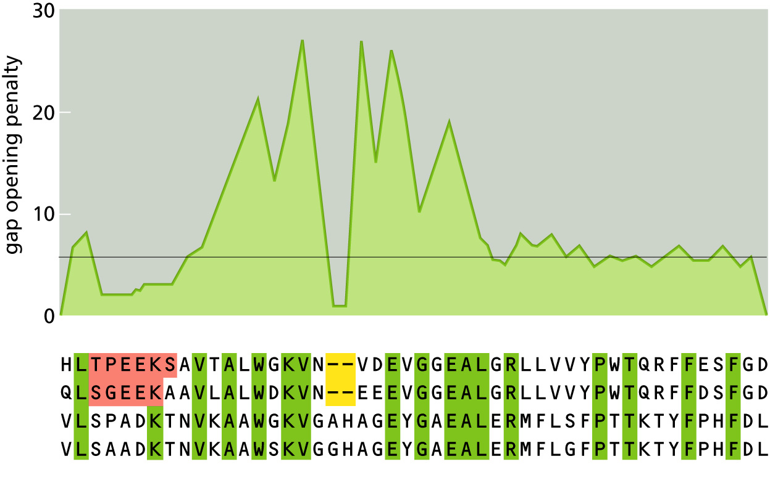
CLUSTAL W
Notes:
As you can see the gap penalties are not constant. They change by position. Gap penalties where gaps already occur are very low, while penalties in the immediate neighborhood are increased to force the appearance of new gaps where gaps already exist in the alignment. You'll notice a lot of fluctuation and that's due to residue-specific gap penalties. Insertions and deletions (indels) are commonly found near aas with short side chains like aspartate, asparagine, glycine, serine, etc. Similarly, indels are common in stretches of 5 or more hydrophilic residues.

Slide 12
CLUSTAL W may not yield meaningful results if …
Sequences in the set are unrelated
Some sequences in the set are of greatly varying lengths (have accumulated long insertions or deletions or both; remember MSAs are global alignments)
Sequences have diverged considerably and evolutionary sampling of sequences in the set is poor (esp. when the dataset is small)
Sequences are non-globular proteins (i.e., intrinsically unstructured proteins) or harbor long stretches of intrinsically unstructured regions
Notes:
Sequences must be related for the construction of MSAs – otherwise, you have garbage-in, garbage-out situation.
Sequences of greatly varying lengths will result in a lot of indels in the MSA which may not be informative (unless there are one or more conserved domains where indels are few).
If the number of sequences in the dataset is small and the sequences in the set are greatly diverged from each other, then expect a lot of errors in the alignment. It's not uncommon to generate MSAs with thousands or even tens of thousands of sequences.
The empirical rules (esp. for gap penalties) for CLUSTAL W were developed based on structures of globular proteins, and therefore, MSAs of sequences of intrinsically unstructured or disordered proteins are a challenge.

Slide 13
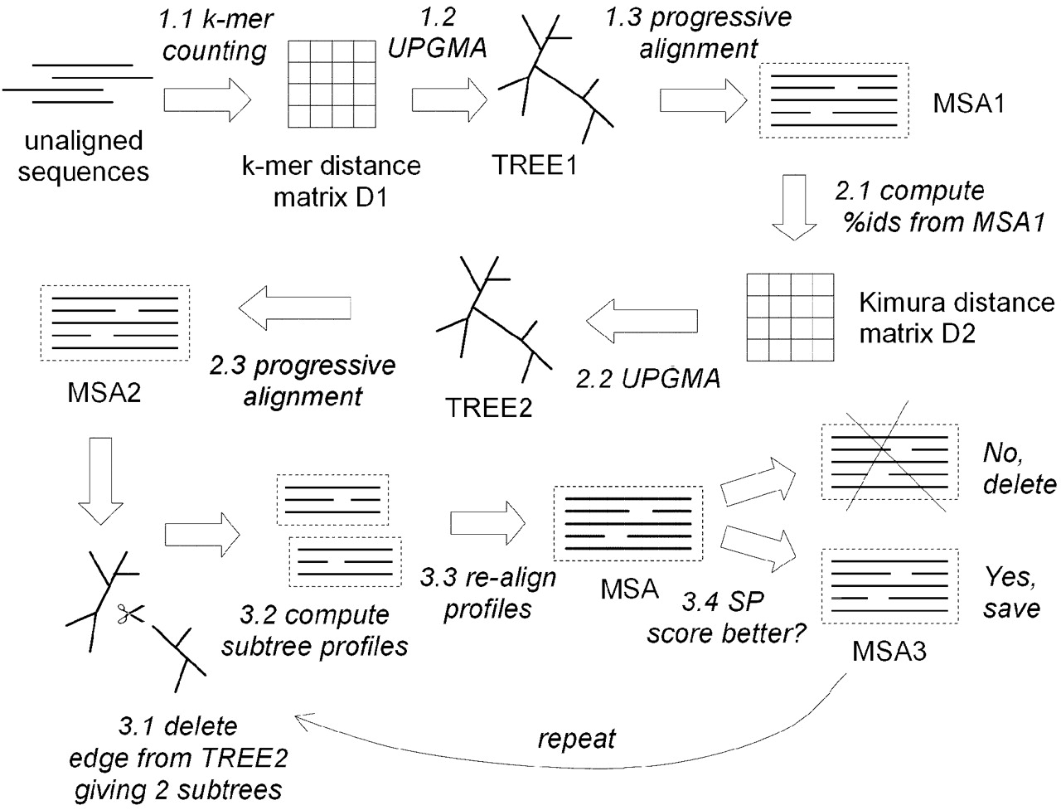
MUSCLE
Edgar R C Nucl. Acids Res. 2004;32:1792-1797
Notes:
Remember the local minimum problem – i.e., once sequences are aligned, the alignments are fixed and that errors can propagate? Here's an alternative approach called MUSCLE that generates alignments iteratively and provides a mechanism for correcting these errors.
It randomly deletes branches in a tree and tries alternative schedules of aligning sub-alignments. This iterative approach seeks to overcome, in part, issues relating to the local minimum problem.
General tip: If you are not satisfied with the MSA computed by a particular tool or if you want to cross check the results, then use a different tool to compare results.

